Slide 1
MSDM 5003 Week 13 27 November 2025 Other Population Games
Outline:
1. Evolutionary Minority Games
2. Adaptive Minority Games
3. The Kolkata Paise Restaurant Problem

Slide 2
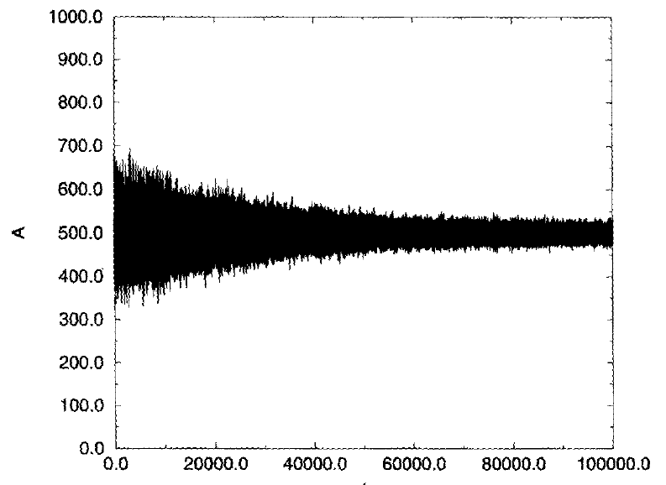
1. Evolutionary Minority Games¹
The worst player is replaced by a new one after some time-steps.
The new player is a clone of the best player.
The virtual scores of the new player’s strategies are reset to zero.
Mutation: Replace one strategy of the best player by a new one.
Result: The population is able to learn by reducing their fluctuations.
¹ Challet D and Zhang Y-C (1997) Emergence of cooperation and organization in an evolutionary game. Physica A 246 407-418.

Slide 3
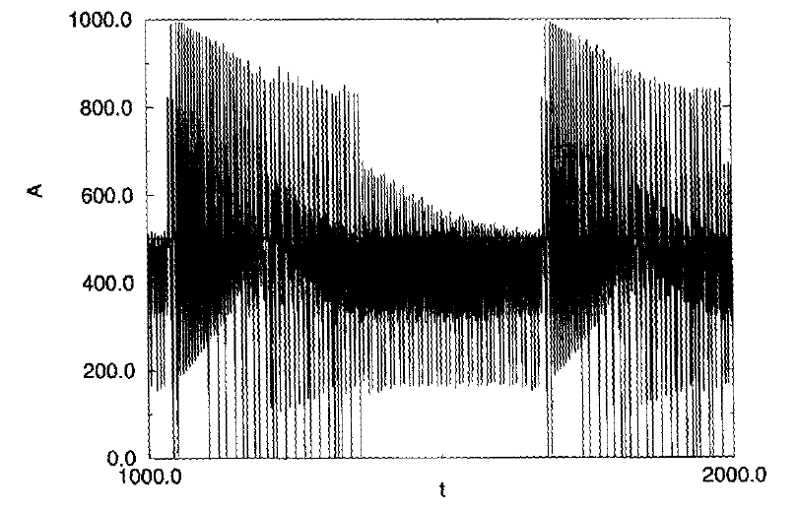
Comparison
Comparison with the case with no mutation
Conclusion: Diversity is important.

Slide 4
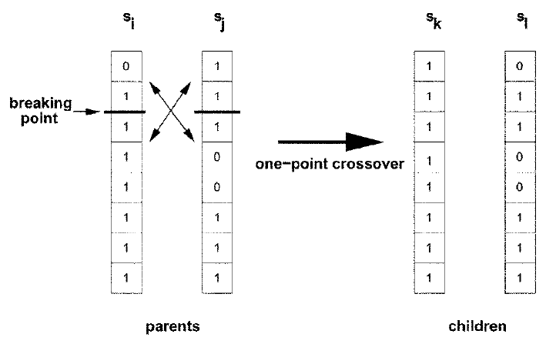
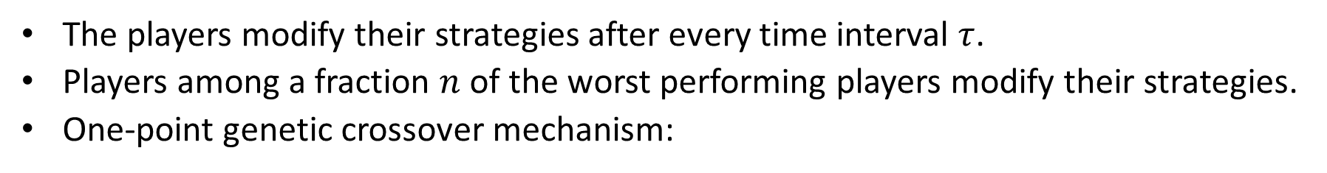
2. Adaptive Minority Games²
The players modify their strategies after every time interval $τ$.
Players among a fraction $n$ of the worst performing players modify their strategies.
One-point genetic crossover mechanism:
² Sys-Aho M, Chakraborti A, and Kaski K (2003) Biology helps you to win a game. Physica Scripta T 106 32.

Slide 5
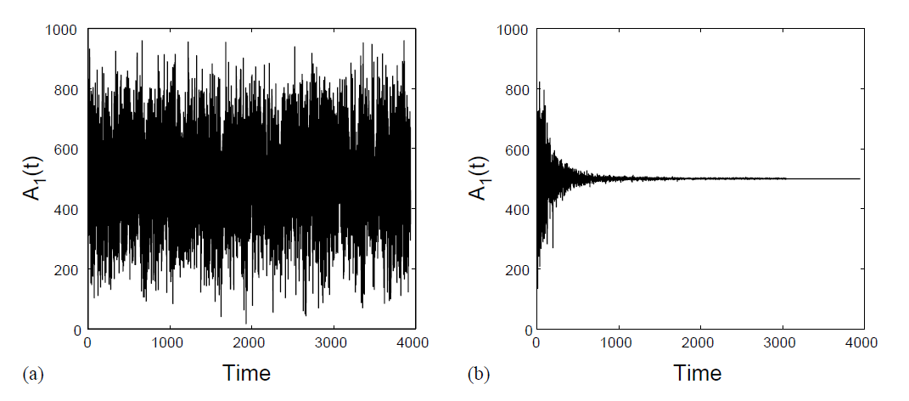
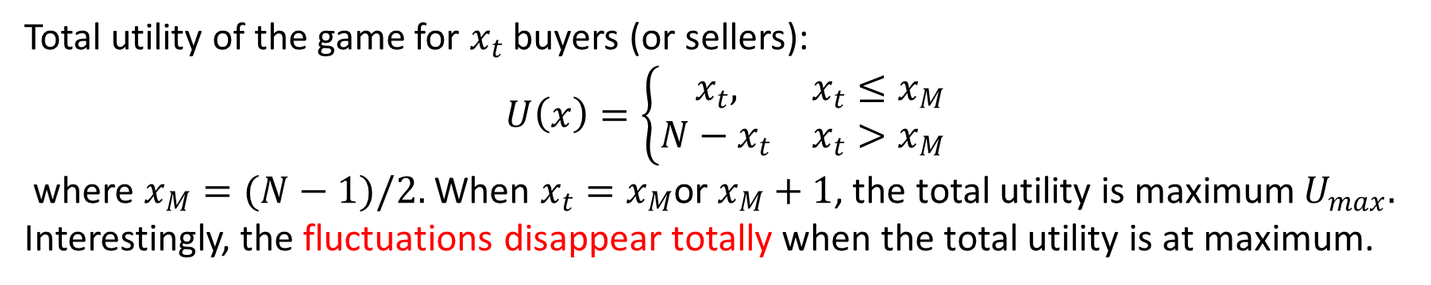
Fluctuations Disappear!
Total utility of the game for $x_{t}$ buyers (or sellers):
$U\left(x\right)=\left\{\begin{matrix}x_{t}, & x_{t}≤x_{M} \\ N−x_{t} & x_{t}>x_{M}\end{matrix}\right.$
where $x_{M}=(N−1)/2.$ When $x_{t}=x_{M}$or $x_{M}+1$, the total utility is maximum $U_{max}.$ Interestingly, the fluctuations disappear totally when the total utility is at maximum.
Basic minority game (left) vs adaptive minority game (right)

Slide 6
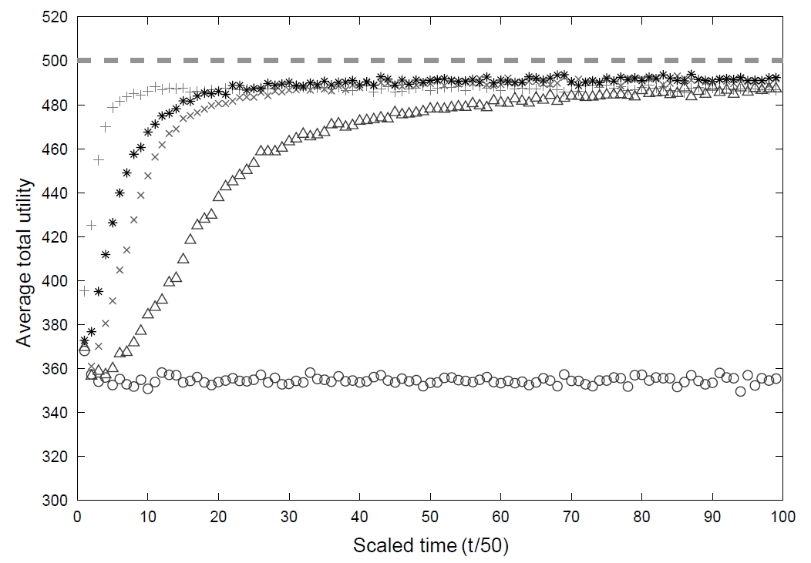
More Experiments
τ = 10, n = 0.6
τ = 50, n = 0.6
τ = 10, n = 0.2
τ = 50, n = 0.2
Basic Minority Game
The time of adaptation has to be optimal (not too frequent or slow).

Slide 7
Strategy Pool Experiments
Experiments on the strategy pools of the agents:
Best two
Random two
Worst two
Operation a:
Operation b:
Operation c:
Operation d:

Slide 8
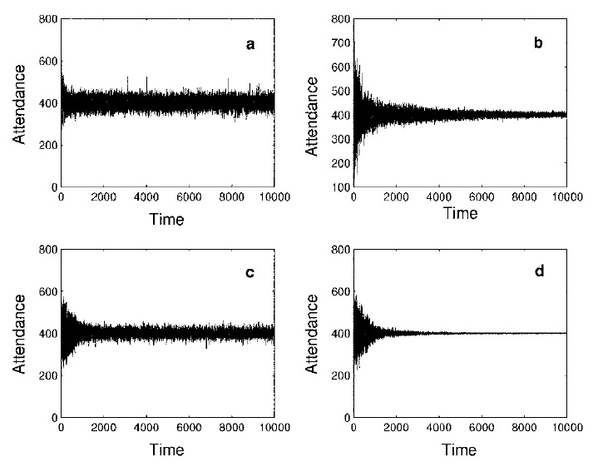
Results
Best two
Random two
Worst two
Operation a:
Operation b:
Operation c:
Operation d:
Operation d is most efficient.

Slide 9
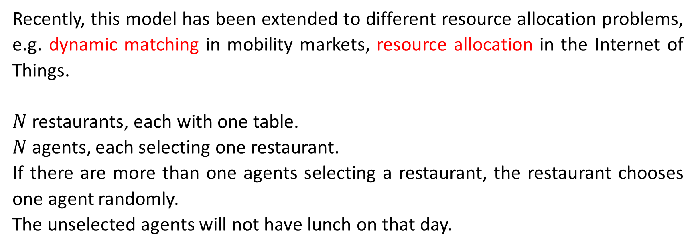
3. The Kolkata Paise Restaurant Problem³
Recently, this model has been extended to different resource allocation problems, e.g. dynamic matching in mobility markets, resource allocation in the Internet of Things.
$N$ restaurants, each with one table.
$N$ agents, each selecting one restaurant.
If there are more than one agents selecting a restaurant, the restaurant chooses one agent randomly.
The unselected agents will not have lunch on that day.
³ Chakraborti AS, Chakrabarti BK, Chatterjee A, and Mitra M (2009) The Kolkata Paise Restaurant Problem and resource utilization. Physica A 288 2420-2426..

Slide 10
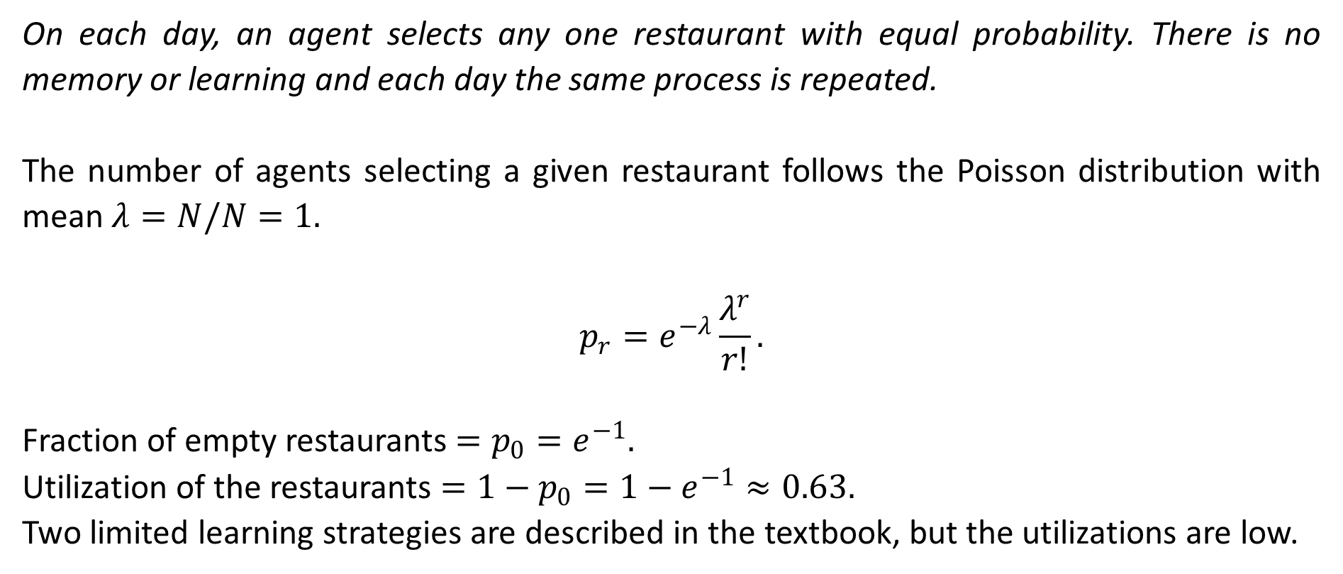
3.1. Repeated Game: No-Learning Strategy
On each day, an agent selects any one restaurant with equal probability. There is no memory or learning and each day the same process is repeated.
The number of agents selecting a given restaurant follows the Poisson distribution with mean $λ=N/N=1.$
$$p_{r}=e^{−λ}\frac{λ^{r}}{r!}.$$
Fraction of empty restaurants $=p_{0}=e^{−1}.$
Utilization of the restaurants $=1−p_{0}=1−e^{−1}≈0.63.$
Two limited learning strategies are described in the textbook, but the utilizations are low.

Slide 11
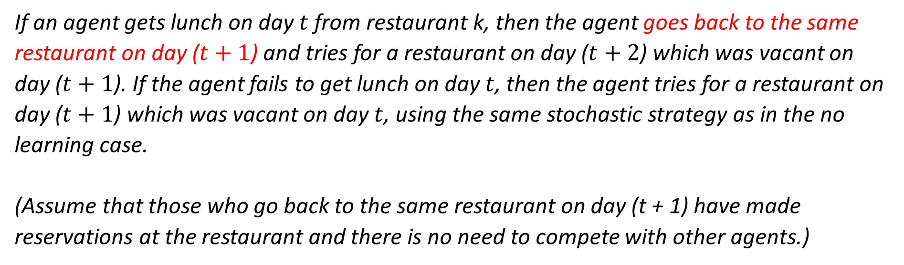
3.2. Repeated Game: One Period Limited Learning Strategy
If an agent gets lunch on day $t$ from restaurant k, then the agent goes back to the same restaurant on day ($t+1$) and tries for a restaurant on day ($t+2$) which was vacant on day ($t+1$). If the agent fails to get lunch on day $t$, then the agent tries for a restaurant on day ($t+1$) which was vacant on day $t$, using the same stochastic strategy as in the no learning case.
(Assume that those who go back to the same restaurant on day (t + 1) have made reservations at the restaurant and there is no need to compete with other agents.)

Slide 12
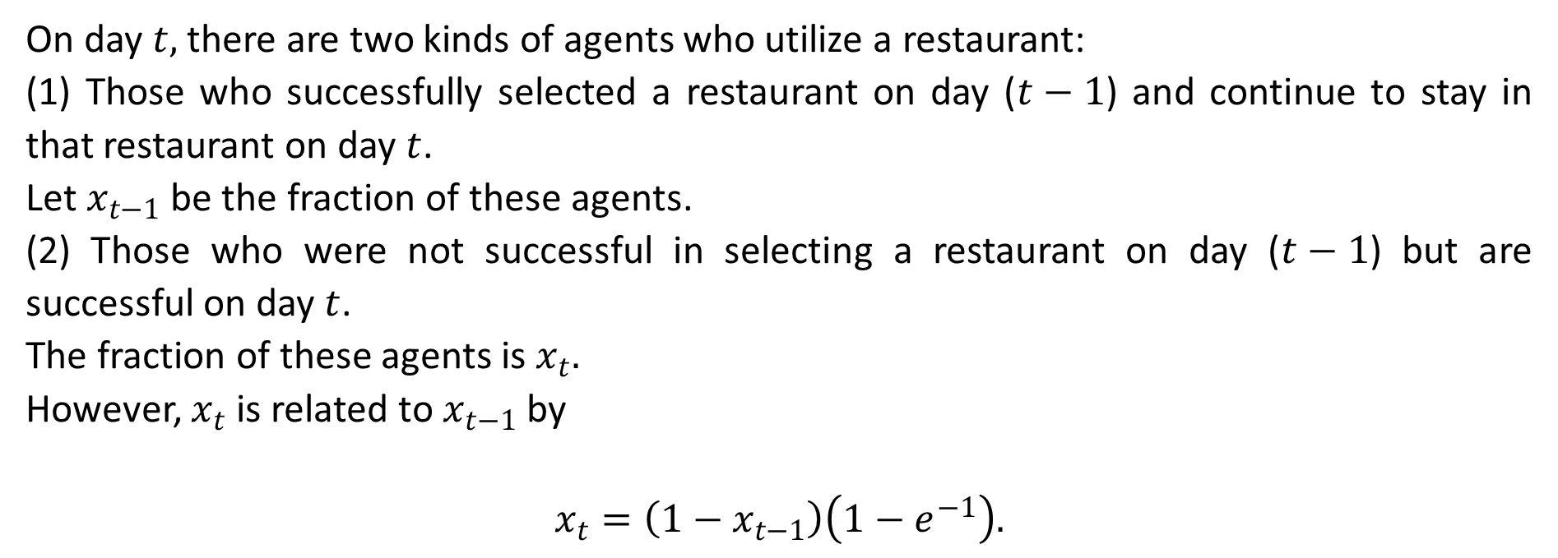
Recursion Relation
On day $t,$ there are two kinds of agents who utilize a restaurant:
(1) Those who successfully selected a restaurant on day ($t−1$) and continue to stay in that restaurant on day $t$.
Let $x_{t−1}$ be the fraction of these agents.
(2) Those who were not successful in selecting a restaurant on day ($t−1$) but are successful on day $t$.
The fraction of these agents is $x_{t}.$
However, $x_{t}$ is related to $x_{t−1}$ by
$$x_{t}=\left(1−x_{t−1}\right)\left(1−e^{−1}\right).$$
Fraction of empty restaurants on the previous day
Utilization of the no-learning strategy

Slide 13
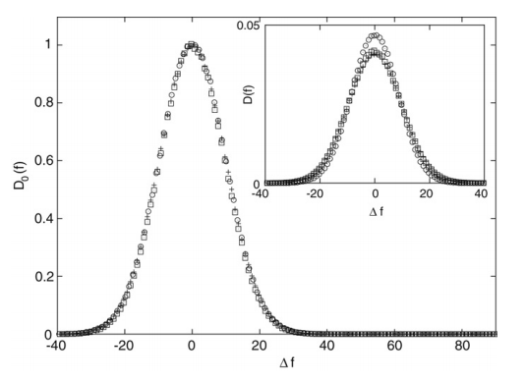
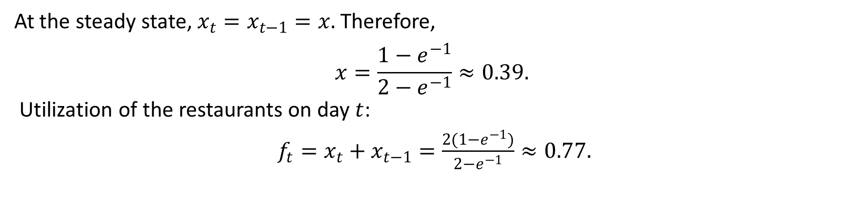
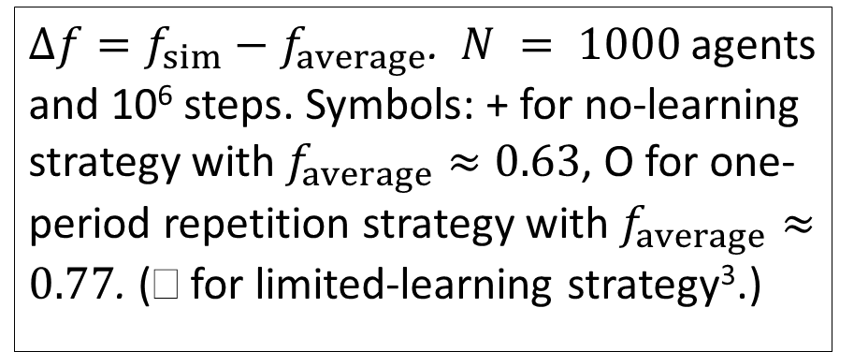
Steady-State Solution
At the steady state, $x_{t}=x_{t−1}=x.$ Therefore,
$$x=\frac{1−e^{−1}}{2−e^{−1}}≈0.39.$$
Utilization of the restaurants on day $t$:
$f_{t}=x_{t}+x_{t−1}=\frac{2(1−e^{−1})}{2−e^{−1}}≈0.77.$
Theoretical prediction agrees with simulation results excellently.
$Δf=f_{sim}−f_{average}$. $N = 1000$agents and 10⁶ steps. Symbols: + for no-learning strategy with $f_{average}≈0.63$, O for one-period repetition strategy with $f_{average}≈0.77$. ( for limited-learning strategy³.)

Slide 14
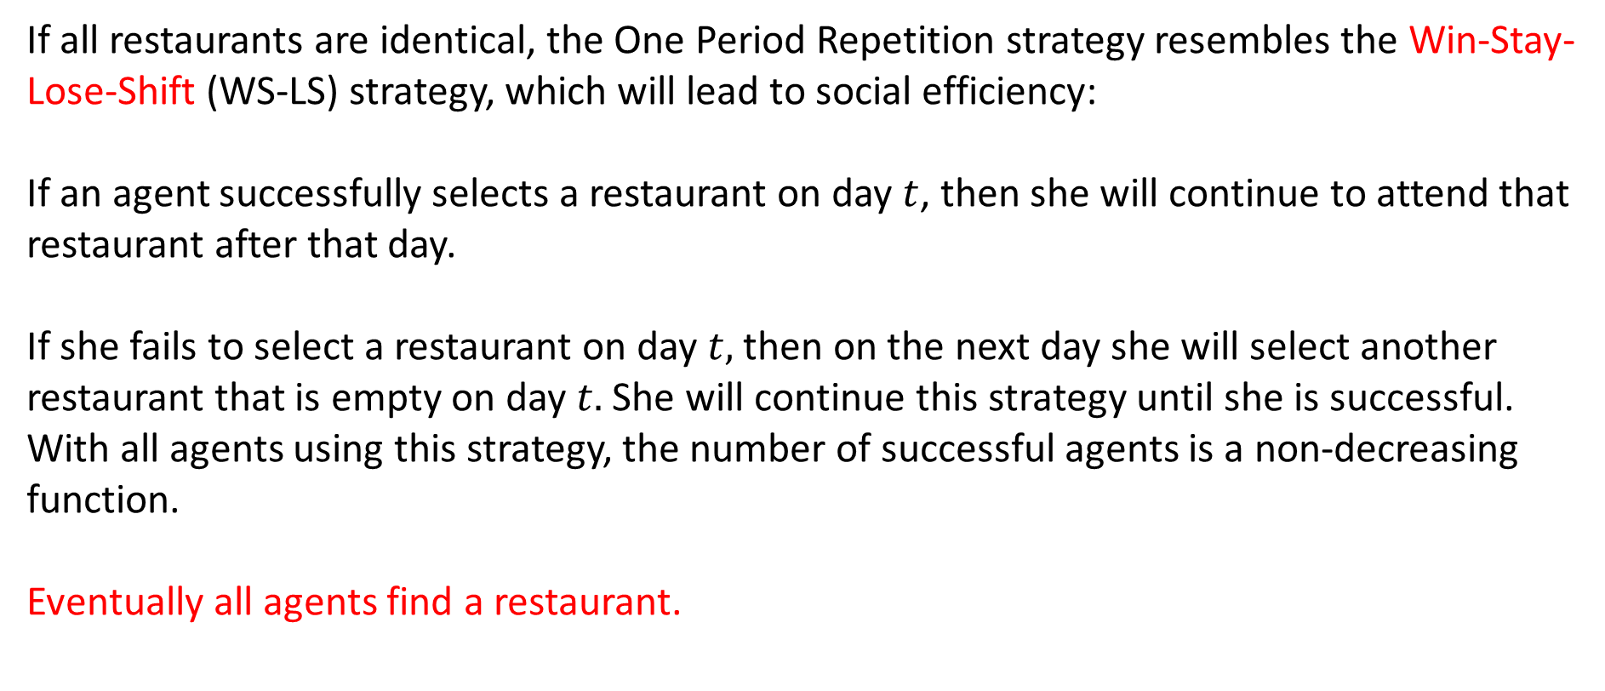
Win-Stay-Lose-Shift
If all restaurants are identical, the One Period Repetition strategy resembles the Win-Stay-Lose-Shift (WS-LS) strategy, which will lead to social efficiency:
If an agent successfully selects a restaurant on day $t$, then she will continue to attend that restaurant after that day.
If she fails to select a restaurant on day $t,$ then on the next day she will select another restaurant that is empty on day $t.$ She will continue this strategy until she is successful.
With all agents using this strategy, the number of successful agents is a non-decreasing function.
Eventually all agents find a restaurant.

Slide 15
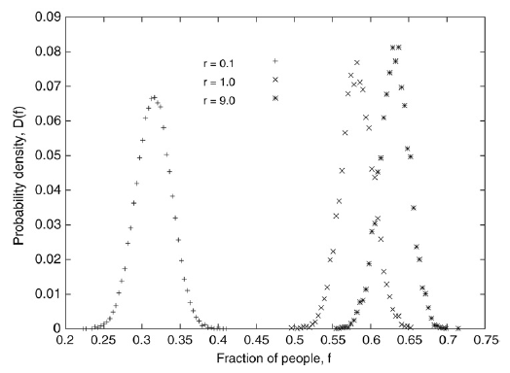
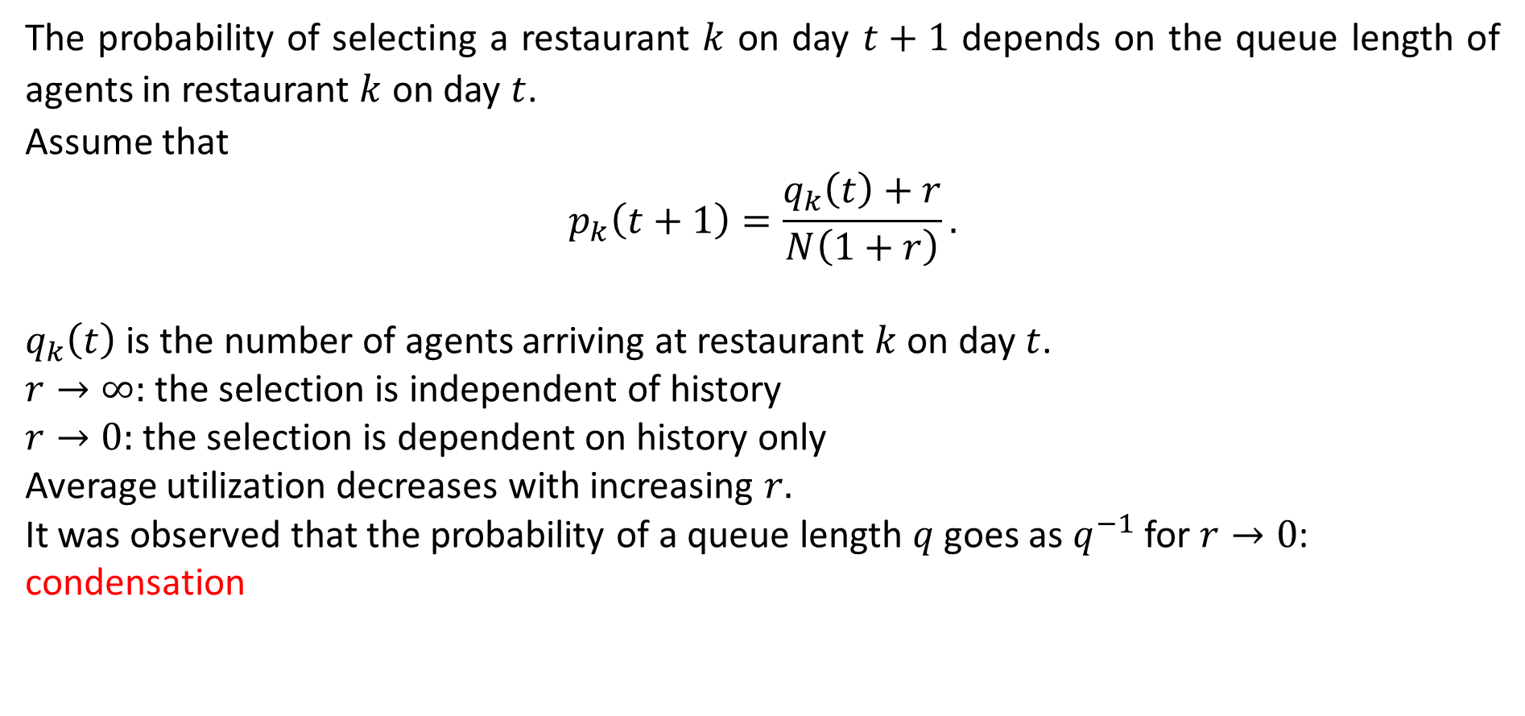
3.3. Follow-the-Crowd Strategy
The probability of selecting a restaurant $k$ on day $t+1$ depends on the queue length of agents in restaurant $k$ on day $t$.
Assume that
$$p_{k}\left(t+1\right)=\frac{q_{k}\left(t\right)+r}{N\left(1+r\right)}.$$
$q_{k}\left(t\right)$ is the number of agents arriving at restaurant $k$ on day $t$.
$r→∞:$ the selection is independent of history
$r→0:$ the selection is dependent on history only
Average utilization decreases with increasing $r.$
It was observed that the probability of a queue length $q$ goes as $q^{−1}$ for $r→0$: condensation

Slide 16

Avoid-the-Crowd Strategy
$$p_{k}\left(t+1\right)=1−\frac{q_{k}\left(t\right)+r}{N\left(1+r\right)}.$$
The most probable utilization is observed to be $f≈0.63$ independent of $r.$

Slide 17
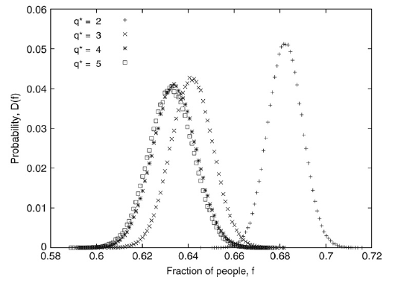
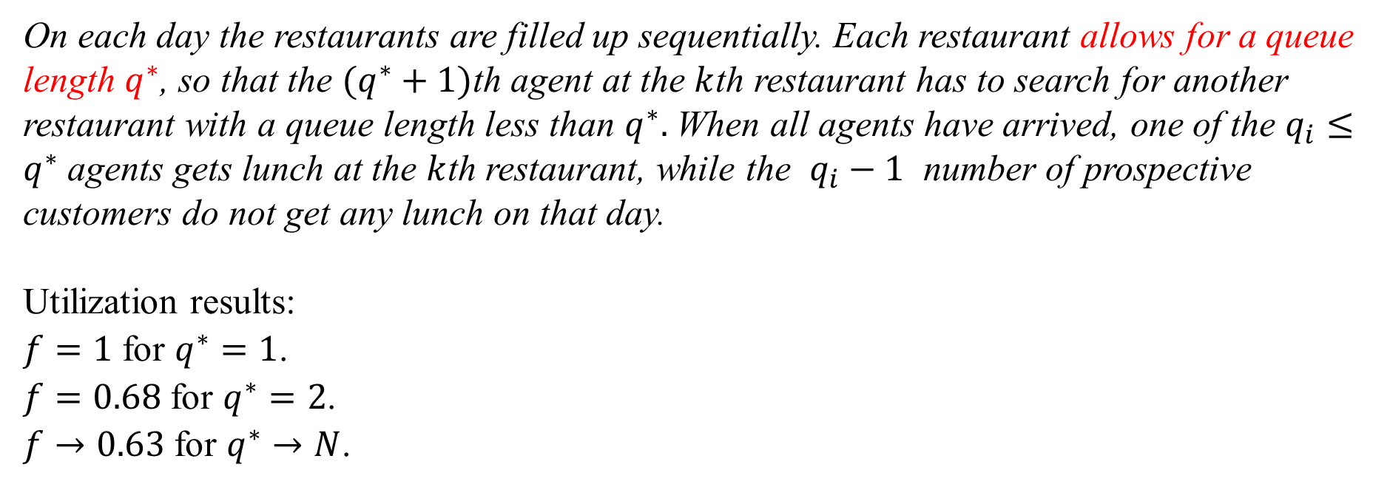
3.4. Modified KPR Problem
On each day the restaurants are filled up sequentially. Each restaurant allows for a queue length $q^{∗}$, so that the $(q^{∗}+1)$th agent at the $k$th restaurant has to search for another restaurant with a queue length less than $q^{∗}.$ When all agents have arrived, one of the $q_{i}≤q^{∗}$ agents gets lunch at the $k$th restaurant, while the $q_{i}−1$ number of prospective customers do not get any lunch on that day.
Utilization results:
$f=1$ for $q^{∗}=1$.
$f=0.68$ for $q^{∗}=2$.
$f→0.63$ for $q^{∗}→N$.

Slide 18
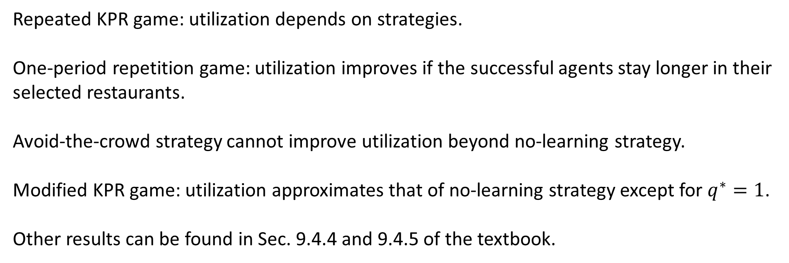
3.5. Summary
Repeated KPR game: utilization depends on strategies.
One-period repetition game: utilization improves if the successful agents stay longer in their selected restaurants.
Avoid-the-crowd strategy cannot improve utilization beyond no-learning strategy.
Modified KPR game: utilization approximates that of no-learning strategy except for $q^{∗}=1$.
Other results can be found in Sec. 9.4.4 and 9.4.5 of the textbook.

